Slide 1




Cloud Engineering
Presented by :
Caleb Okkers
Quickbook
AWS Scalable Web App

Slide 2


01
Design highly available AWS architecture
02
Deploy infrastructure using Terraform
03
Host frontend and backend securely
04
Implement monitoring and alarms
05
Control costs using AWS Budgets
Objectives
06
Automate deployments with CI/CD
07
Deliver a production-ready system

Slide 3
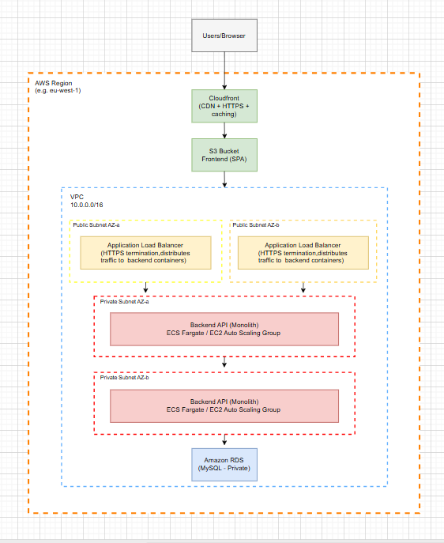
Architectural Diagram

Slide 4


System Workflow
User hits frontend CloudFront URL
SPA calls API CDN
CloudFront → ALB
ALB → EC2 container
EC2 → RDS
Response returned

Slide 5
AWS Services Used
VPC / Subnets / IGW
EC2 Auto Scaling Group
Application Load Balancer
Amazon RDS
S3
CloudFront
ECR
Systems Manager Parameter Store
CloudWatch
AWS Budgets
GitHub Actions
Terraform

Slide 6

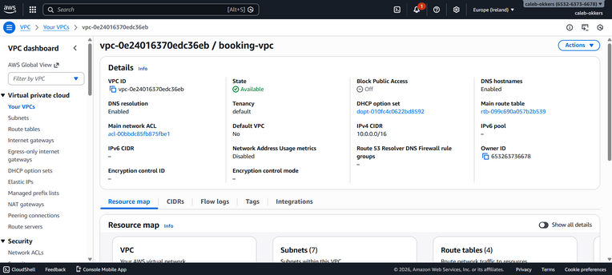
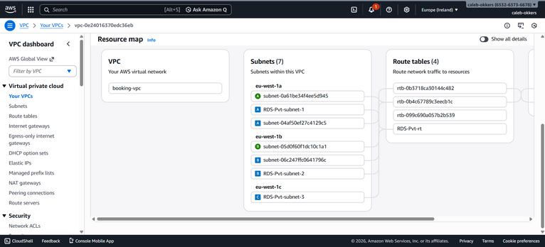

Networking Design
VPC
SUBNETS
KEY POINTS
Database never public
Backend isolated
Only ALB exposed

Slide 7
Security group chaining
Least-privilege IAM roles
Secrets stored in SSM
HTTPS enforced
No public DB access
CORS restrictions
Containerized workloads
Security Model

Slide 8
Docker → ECR → EC2
Launch template user-data
ASG health checks
Instance refresh for releases
Node.js API
Pulls secrets from SSM
Auto-healing
Backend Deployment

Slide 9
Vite build output
S3 static hosting
CloudFront CDN
Cache invalidation
HTTPS
Global distribution
Low latency
Frontend Deployment

Slide 10
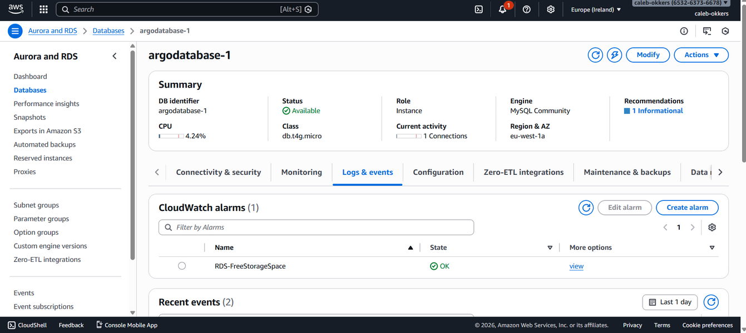
RDS MySQL
Private subnet
SG rules
Managed backups
Monitoring
Security-group-only access
Database Layer

Slide 11
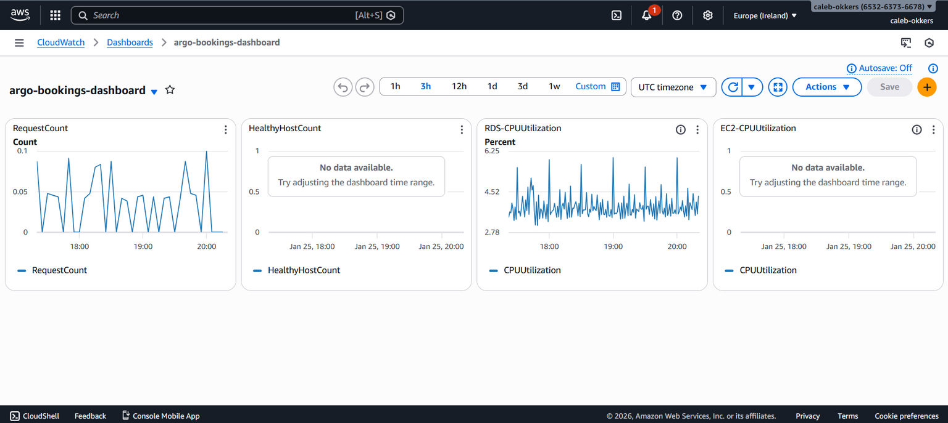
CPU utilization
ALB healthy hosts
RDS storage
Request count
Monitoring Setup

Slide 12
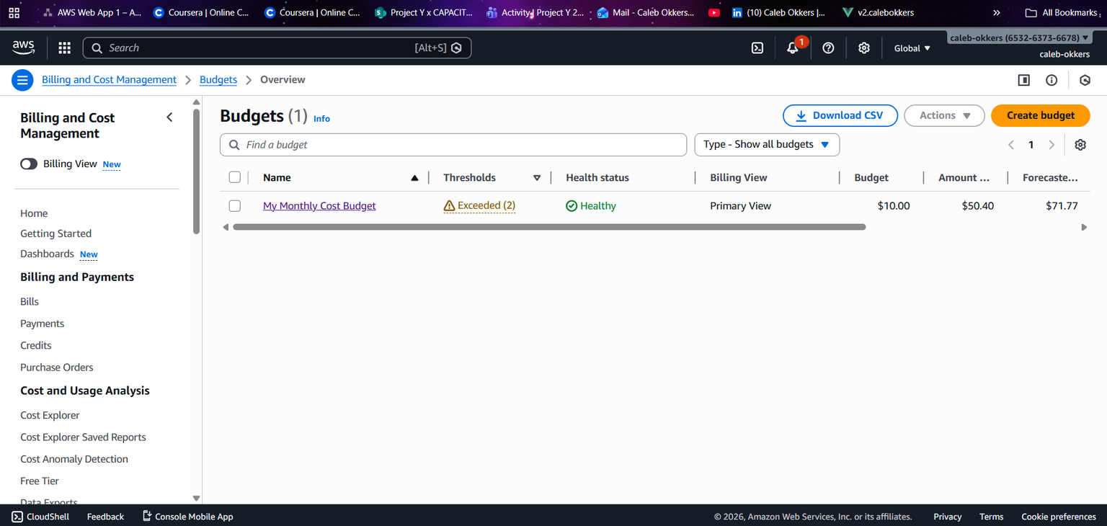
Budget alerts
Free-tier sizing
Auto Scaling limits
Cost Optimization

Slide 13
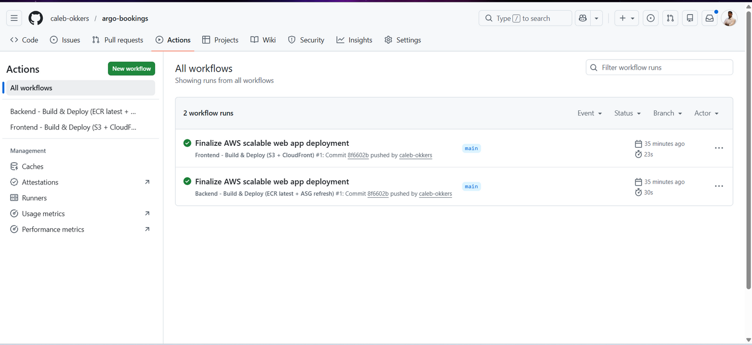
Build
Test
Push to ECR
Deploy backend
Build frontend
Upload to S3
Invalidate CloudFront
CI/CD Pipeline

Slide 14
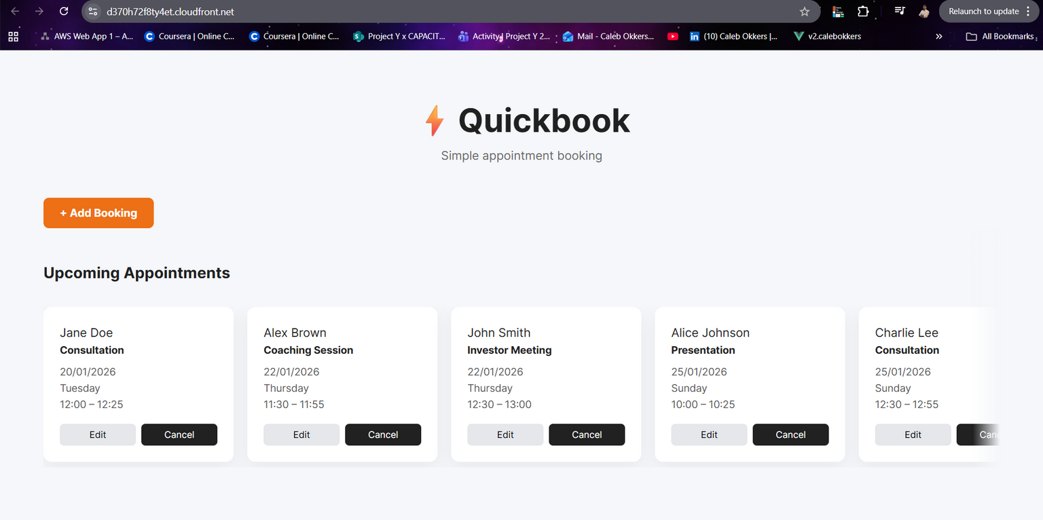
Simple Booking App
Mobile First/ Responsive
Smooth UI
Quick to Market
Deployed App

Slide 15
ASG self-healing
ALB load balancing
CDN caching
Horizontal scale ready
Multi-AZ capable DB
Scalability & Resilience

Slide 16
Honest constraints:
Single EC2 instance
No Redis cache yet
IAM OIDC not implemented
No WAF
Local logs only
Limitations

Slide 17
Roadmap:
ECS/Fargate
ElastiCache
ACM custom domains\
GitHub OIDC
Blue/green deploys
WAF
Central logging
Future Improvements

Slide 18
Terraform dependency management
CORS and HTTPS issues
SG chaining
CloudFront invalidations
Secure secrets handling
Debugging networking
Lessons Learned

Slide 19
Frontend URL
API endpoint
GitHub repo
Architecture diagram
Final Demo Links

Slide 20
Presented by :
Caleb Okkers
Thank You
for your time and attention

